Slide 1



Once Upon a Time
Introduction to DHIS2

Slide 2

DHIS2 – Starting out
HISP UiO
HISP Centre at the University of Oslo
Notes:
+DHIS2 is a product of the +HISP Centre at the University of Oslo, also known as +HIPS UiO.

Slide 3


DHIS2 – Starting out
HISP
1994
Notes:
HISP is a global action research network, +initiated jointly by the +University of Oslo and the +University of Western Cape in South Africa in +1994,

Slide 4

DHIS2 – Starting out
Norwegian Agency for Development Corporation
HISP
1994
Notes:
with +funding from the +Norwegian Agency for Development Corporation+, Norad..

Slide 5

DHIS2 – Starting out
HISP
District Health Information Software
DHIS
South Africa
1996
Notes:
As a result of the +HISP collaboration, the +District Health Information Software, or +DHIS, was launched in +South Africa +in 1996, starting in one district and

Slide 6

DHIS2 – Starting out
DHIS
South Africa
1996
DHIS becomes national standard
1999
Notes:
becoming their +national standard health information system in 1999.
From its initial conception, the core aim of DHIS2

Slide 7


DHIS2 – Starting out
DHIS2 supports local management of healthcare delivery
1999
Notes:
has been to +support local management of health care delivery and information flows in low and middle-income countries.

Slide 8


DHIS2 – Starting out
DHIS2 supports local management of healthcare delivery
1999
DHIS2
Digital Public Good
Notes:
+To that end, we share our software, DHIS2, globally as a digital public good.

Slide 9

DHIS2 – Original features
DHIS
Notes:
The +original DHIS software +functioned using local, offline databases,.

Slide 10
DHIS2 - Original features
DHIS
Aggregating data
Sharing data
Scaling up
Notes:
but this resulted in challenges +in aggregating & +sharing data, as well as +scaling up implementations over time.

Slide 11
DHIS2 - Evolution
DHIS
Aggregating data
Sharing data
Scaling up
DHIS2 development begins
2004
Notes:
+As a result, in 2004, development of a web-based DHIS2 began at the University of Oslo.

Slide 12


DHIS2 functionalities
Latest technologies
Web-based
DHIS2 development begins
Users can enter and access their data anywhere
2004
Notes:
As DHIS2 is +web-based, +users can enter and access their data anywhere with +internet connectivity. This model is still being expanded upon today, as DHIS2 incorporates the latest +web-based technologies to improve DHIS2’s performance and increase its functionality.

Slide 13
DHIS2 functionalities
Offline data entry
Mobile application
2004
DHIS2 development begins
Notes:
This includes +offline data entry for areas with internet connectivity challenges, and the +incorporation of a mobile application for Android devices.

Slide 14
DHIS2 functionalities
First DHIS2 implementation
Kerala, India
2006
Notes:
The +first implementation of the web-based DHIS2 software was launched in +2006 in Kerala, India.

Slide 15

DHIS2 functionalities
First DHIS2 implementation
2006
2006
Collection of individual data
2009
Notes:
In +2009, DHIS2 added components that allowed for the +collection of individual data.

Slide 16


DHIS2 functionalities
Collection of individual data
2009
Notes:
This was in direct response to +requirements in Kerala where prospective mothers were tracked through their Antenatal care services.

Slide 17
DHIS2 functionalities
2009
DHIS2 Tracker
Notes:
+This individual data model eventually evolved into DHIS2 tracker.

Slide 18
DHIS2 – Branching out
Kenya
Ghana
Uganda
Sierra Leone
Rwanda
2007
2010
Notes:
+2007 saw the first implementation of DHIS2 in +Africa, starting with +Sierra Leone. This was followed in +2010 by +Kenya, then Ghana, Rwanda & Uganda.

Slide 19


DHIS2 Academy
HISP
Regional DHIS2 academies led by the HISP network
2007
2010
Self-paced courses
2011
2017
Notes:
In +2011 the +DHIS2 Academy training program began. +The University of Oslo, in collaboration with HISP groups, offers +regional DHIS2 academies every year on key DHIS2 topics. Since +2017 the university has also run the DHIS2 Online Academy, which provides online courses for self-paced study.

Slide 20

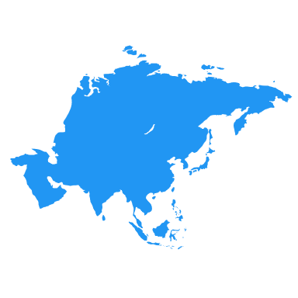
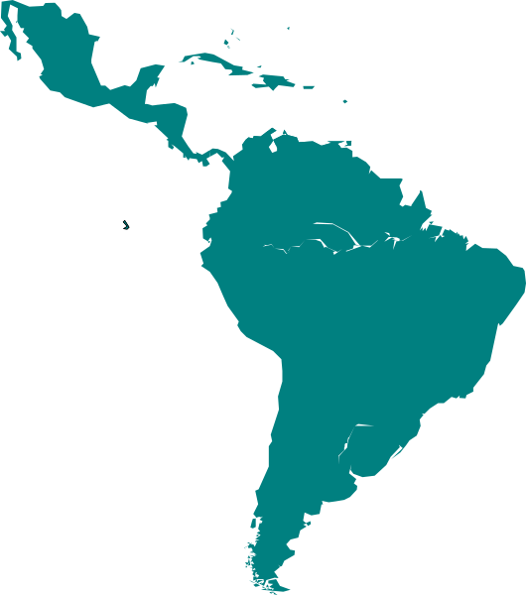
DHIS2 partnerships
DHIS2 as a national platform
2012
2013
Africa
Asia
Latin America
Notes:
In +2012 and 2013, adoption of +DHIS2 as a national platform for routine health information continued in Africa, Asia and Latin America,

Slide 21


DHIS2 partnerships
2012
2013
Notes:
with support from +Norad, the +Global Fund, and +PEPFAR.

Slide 22

Ebola response
HISP
2012
2014
Notes:
In +2014, the HISP network assisted health authorities in

Slide 23
Ebola response
HISP
DHIS2 Tracker
Liberia
2014
Notes:
+Liberia in deploying DHIS2 Tracker for the Ebola outbreak response.

Slide 24





DHIS2 partnerships
HISP
DHIS2 Tracker
COVID-19
2014
Notes:
With the support of the +U.S. Centers for Disease Control and Prevention, +the Gates Foundation, +Gavi, and other partners, The initial Tracker models deployed in Liberia there have since been expanded upon for case-based surveillance of other diseases, +including COVID-19.

Slide 25


DATIM: A PEPFAR version of DHIS2
Standard sharing
Collating data
2015
Notes:
In +2015, +DATIM was launched, a PEPFAR-specific version of DHIS2. DATIM is used by PEPFAR in more than 50 countries. +DATIM continues to be one of the largest examples of a +global data warehouse within DHIS2; +sharing standards and +collating subnational HIV data routinely across large and varied geographies.

Slide 26

UiO: WHO Collaborating Centre
Health information systems strengthening
WHO Collaborating Centre
2017
Notes:
In +2017, +UiO became an official +World Health Organisation +Collaborating Centre for Innovation and Implementation Research for +health information systems strengthening.

Slide 27







Metadata packages
Metadata Package
2017
Notes:
This collaboration led to the +metadata package concept, a method of sharing best practice configuration and functionality, developed by DHIS2 and health subject matter experts.

Slide 28



DHIS2 Community of Practice
2018
Notes:
+2018 saw the +DHIS2 Community of Practice launch, providing an online portal to +help the community of DHIS2 practitioners to connect with each other and share best practice globally.

Slide 29
DHIS2 as EMIS
Education Management Information System
2019
Notes:
+2019 saw +DHIS2 being piloted as an Education Management Information System

Slide 30
DHIS2 as EMIS
School & infrastructure management
Student tracking
Education Management Information System
Gambia
Uganda
2019
Notes:
in the Gambia and Uganda, extending the use of DHIS2 into the education +domain, +for school and infrastructure management, +student tracking, and more.

Slide 31


COVID-19 response
School & infrastructure management
Student tracking
2019
2020
Notes:
In +2020, DHIS2 was quickly adopted to combat the COVID-19 pandemic.

Slide 32
COVID-19 response
COVID-19 metadata packages
Case-based surveillance
Contact tracing
HISP
Ports of entry programs
2020
Notes:
The +University of Oslo worked with the +HISP network to launch +COVID-19 metadata packages that allowed countries to rapidly implement +Case-based Surveillance, +Contact Tracing and +Ports of Entry programs.

Slide 33


COVID-19 response
New metadata packages
2021
Notes:
In +2021, new +metadata packages were released to support delivery of +COVID-19 vaccines, based on previous work developing the DHIS2 immunization toolkit with the support of +WHO, Unicef, and Gavi, the vaccine alliance.

Slide 34
HISP
Digital Public Good
Notes:
+DHIS2 continues to evolve thanks to the work of the core +DHIS2 team and HISP network, +the support of our international partners, and the input of global DHIS2 community, who help sustain DHIS2 as a +global public good that can adapt to meet the health information needs of the future.

